Slide 1
Health Screening Solution
Alli Fox, Zawaad Shah, Aaron Nguyen, Emmett Simmons, Ben Zell

Slide 2

Current Problems
The administrator has been manually booking the appointment screenings by sending a mass email.
This is done by coordinating a proper time for each employee individually.
This is time consuming and inefficient.

Slide 3

Functions
Create a screening event
Manually book an appointment
Edit appointments
Allow employees to book their own appointments

Slide 4

Google Appointments
Already being paid for
Relatively bug-free
Maintained by Google

Slide 5
Admin

Slide 6
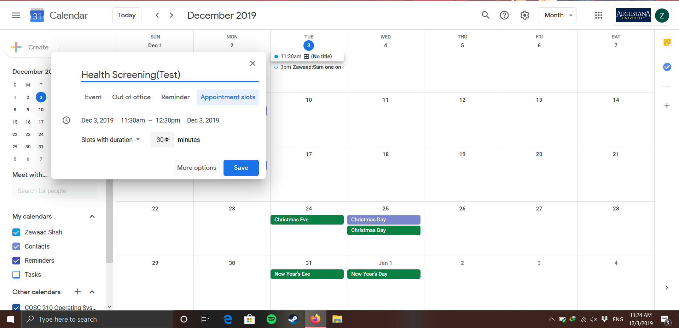
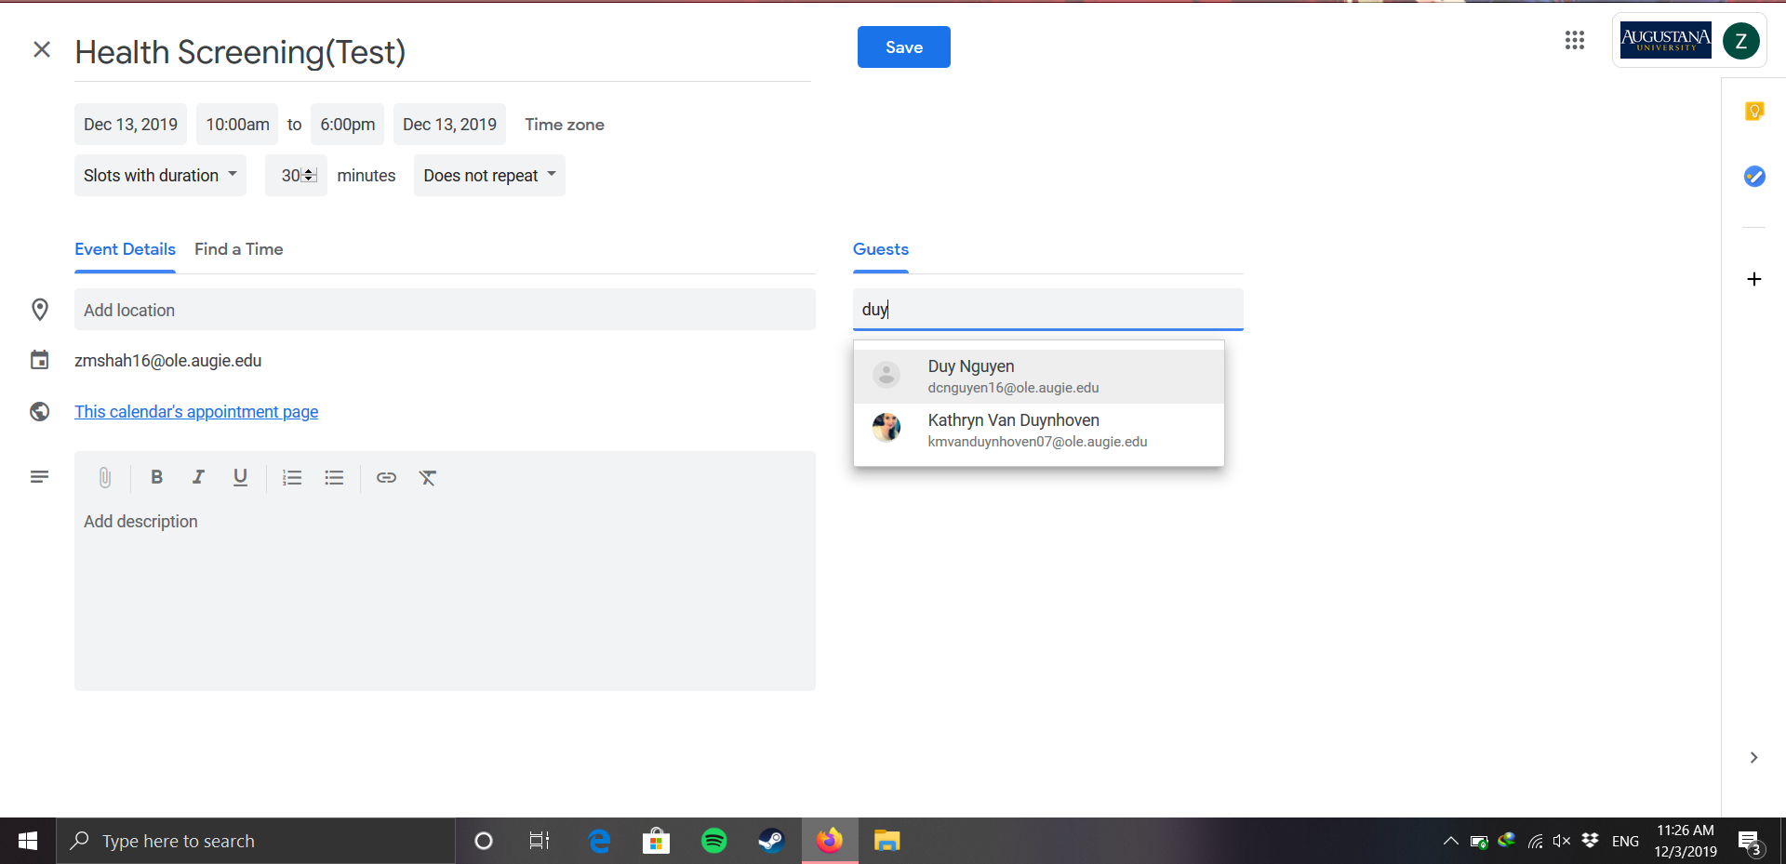
Setting up a Screening

Slide 7
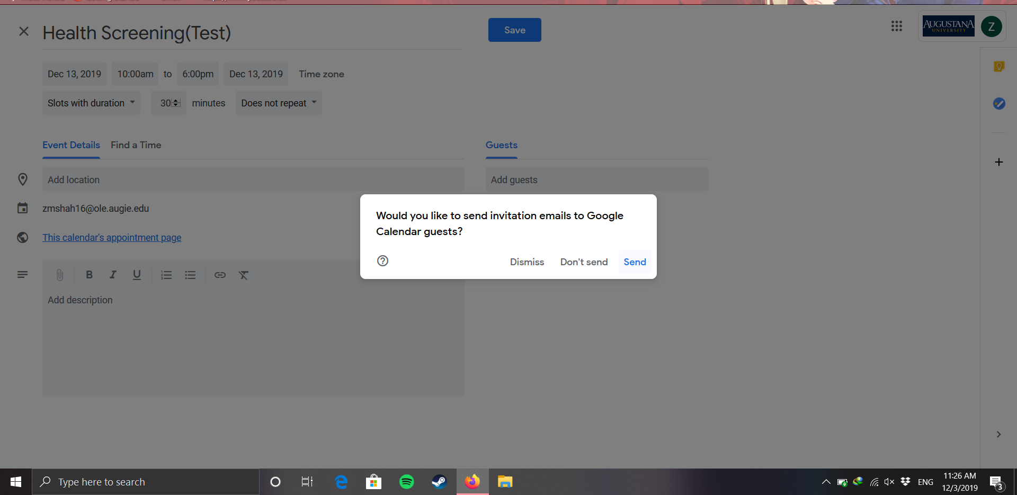
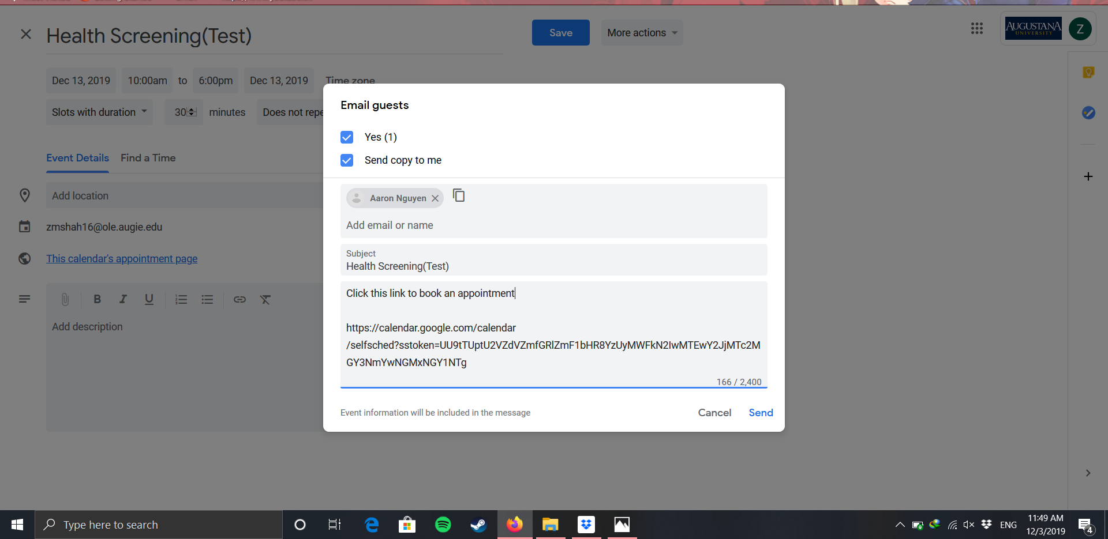

Slide 8
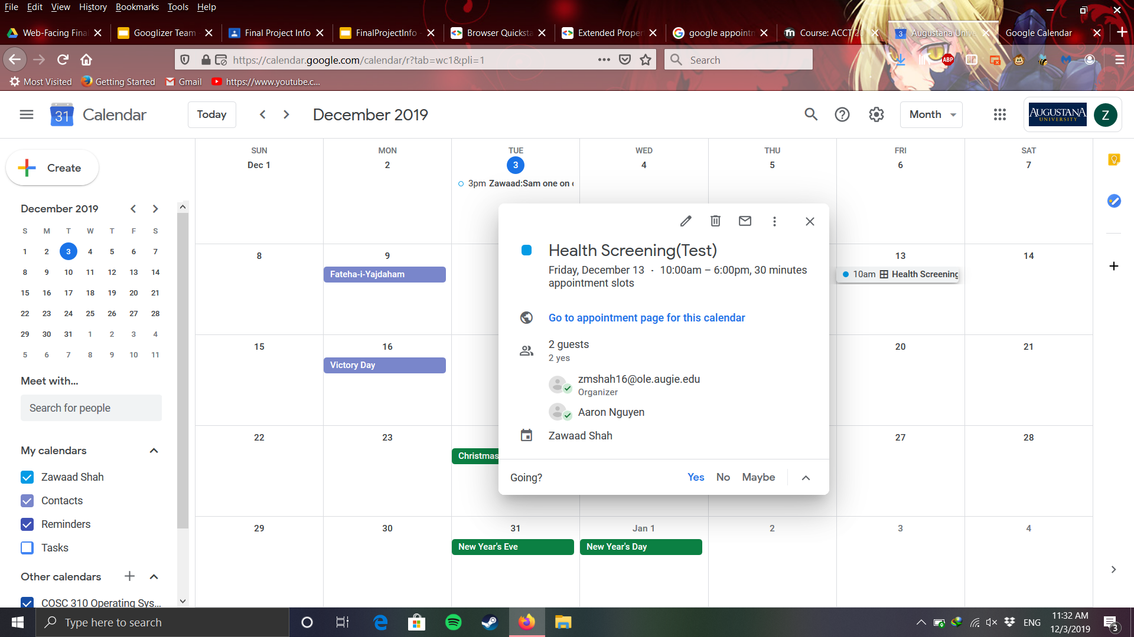
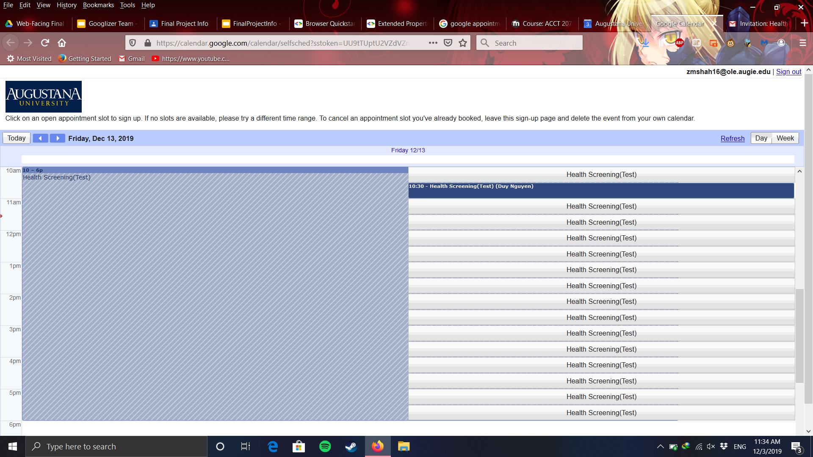

Slide 9
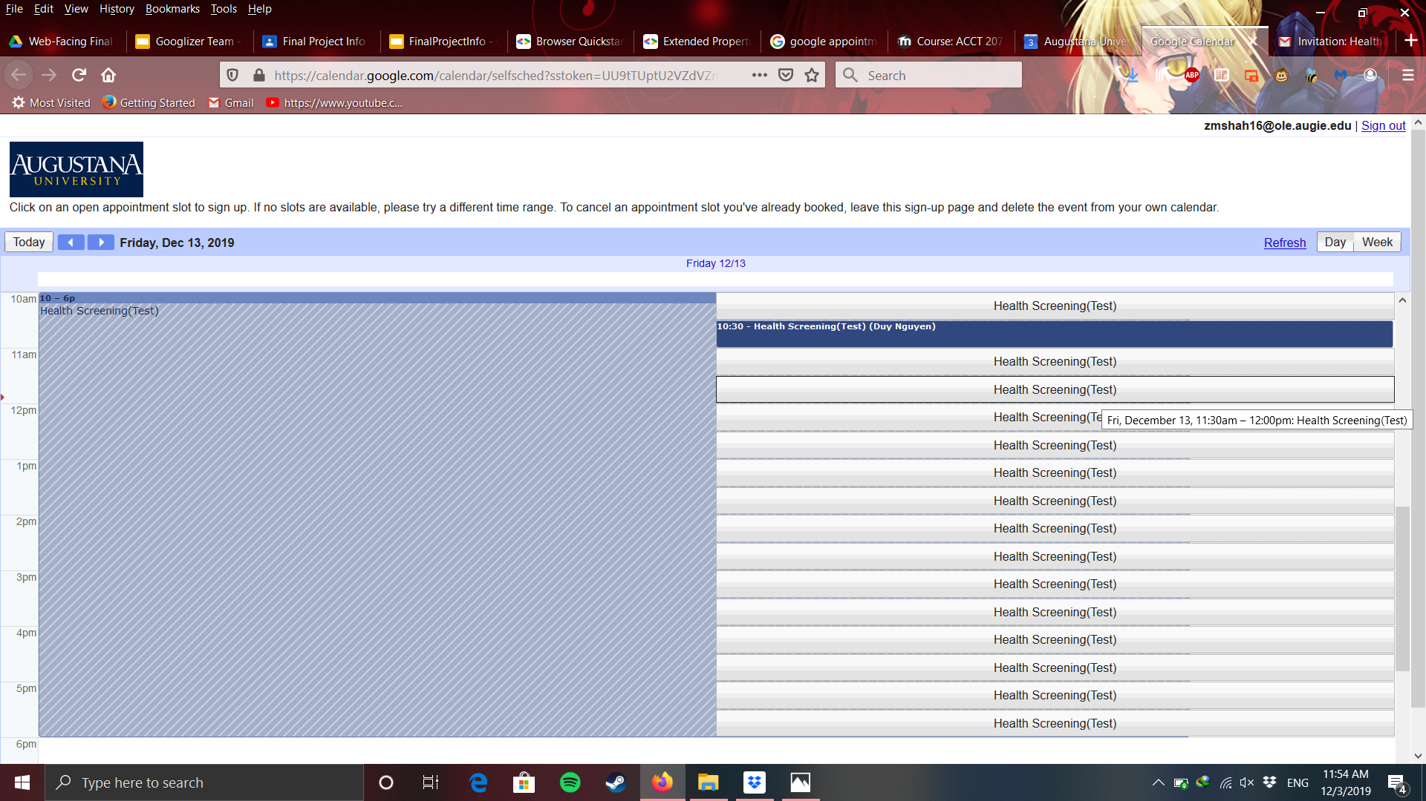
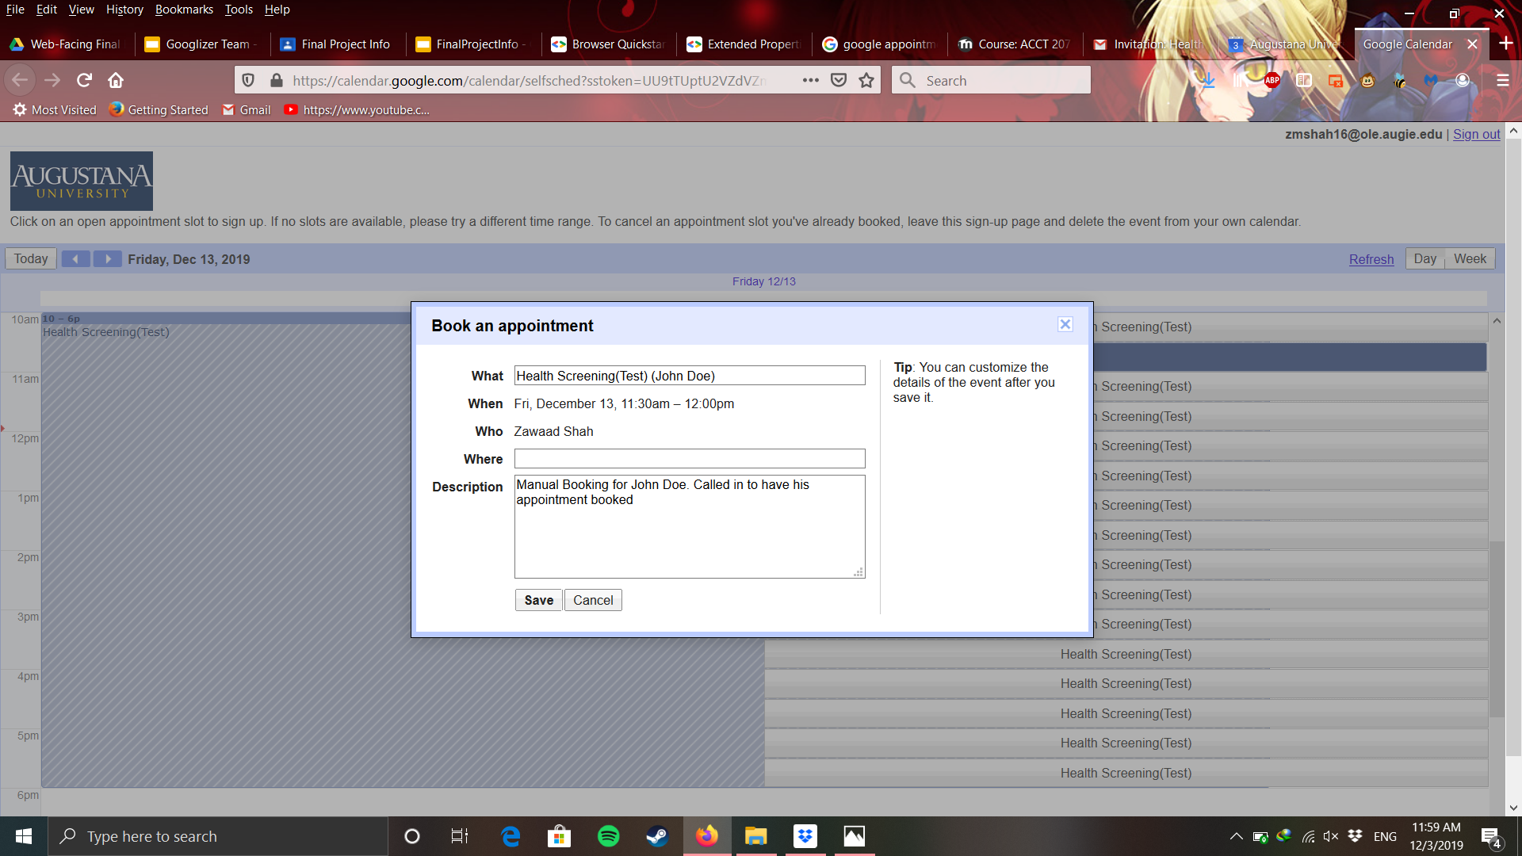
Adding a Booking Manually

Slide 10
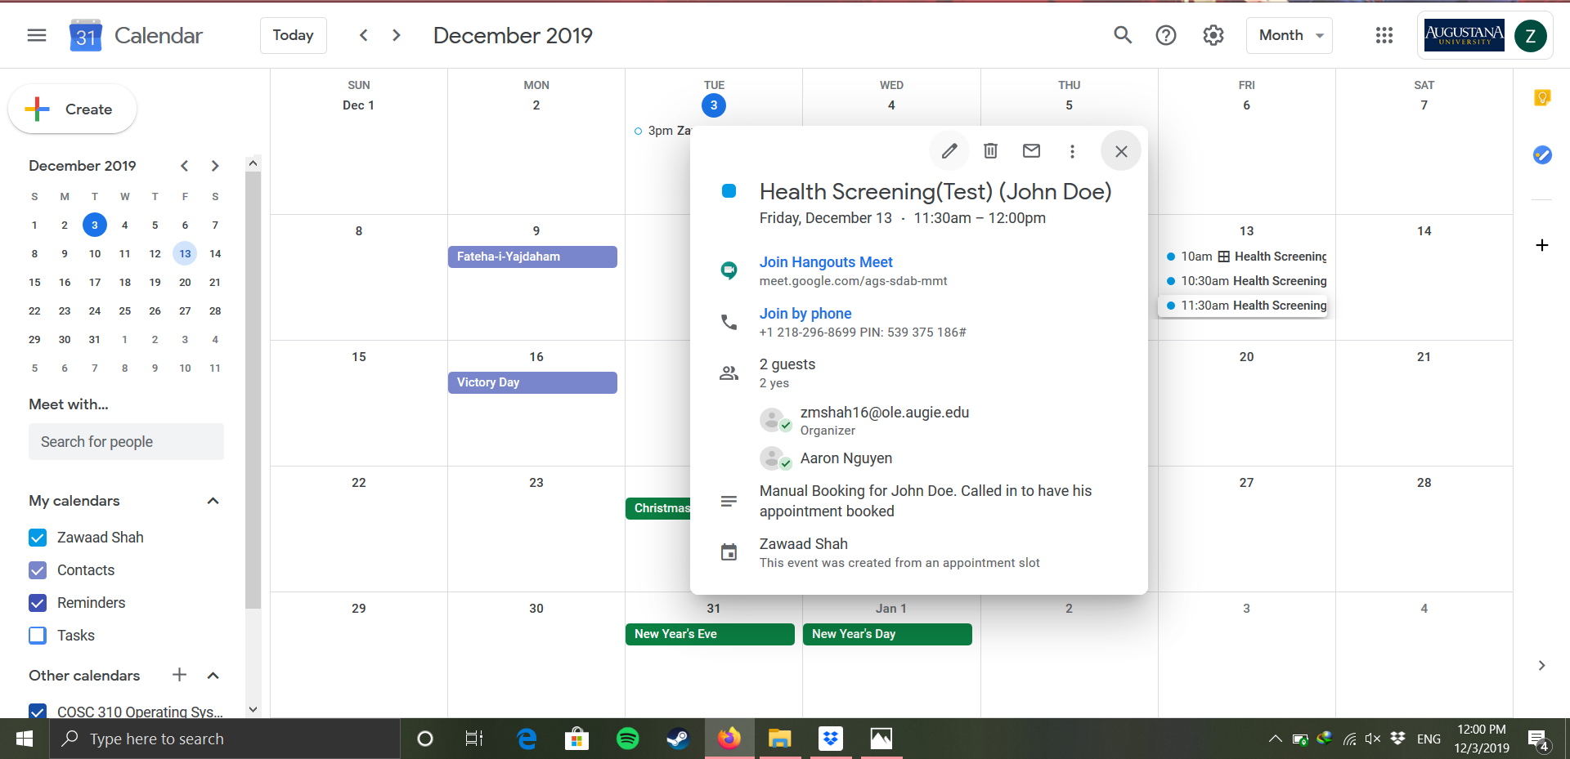

Slide 11
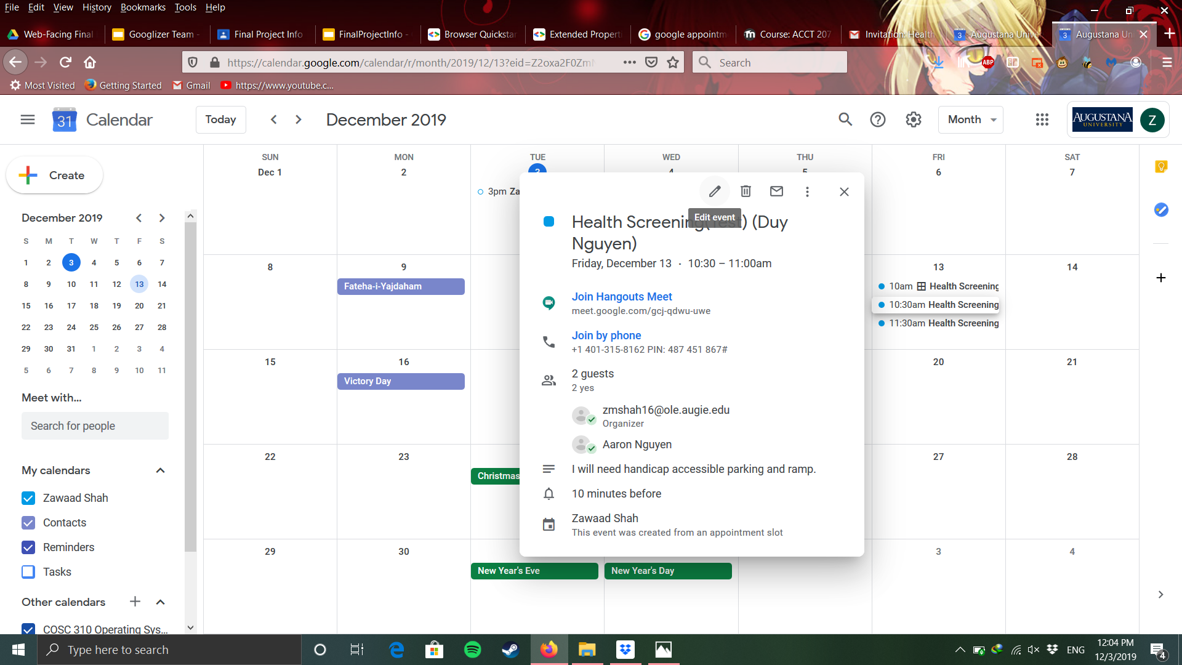
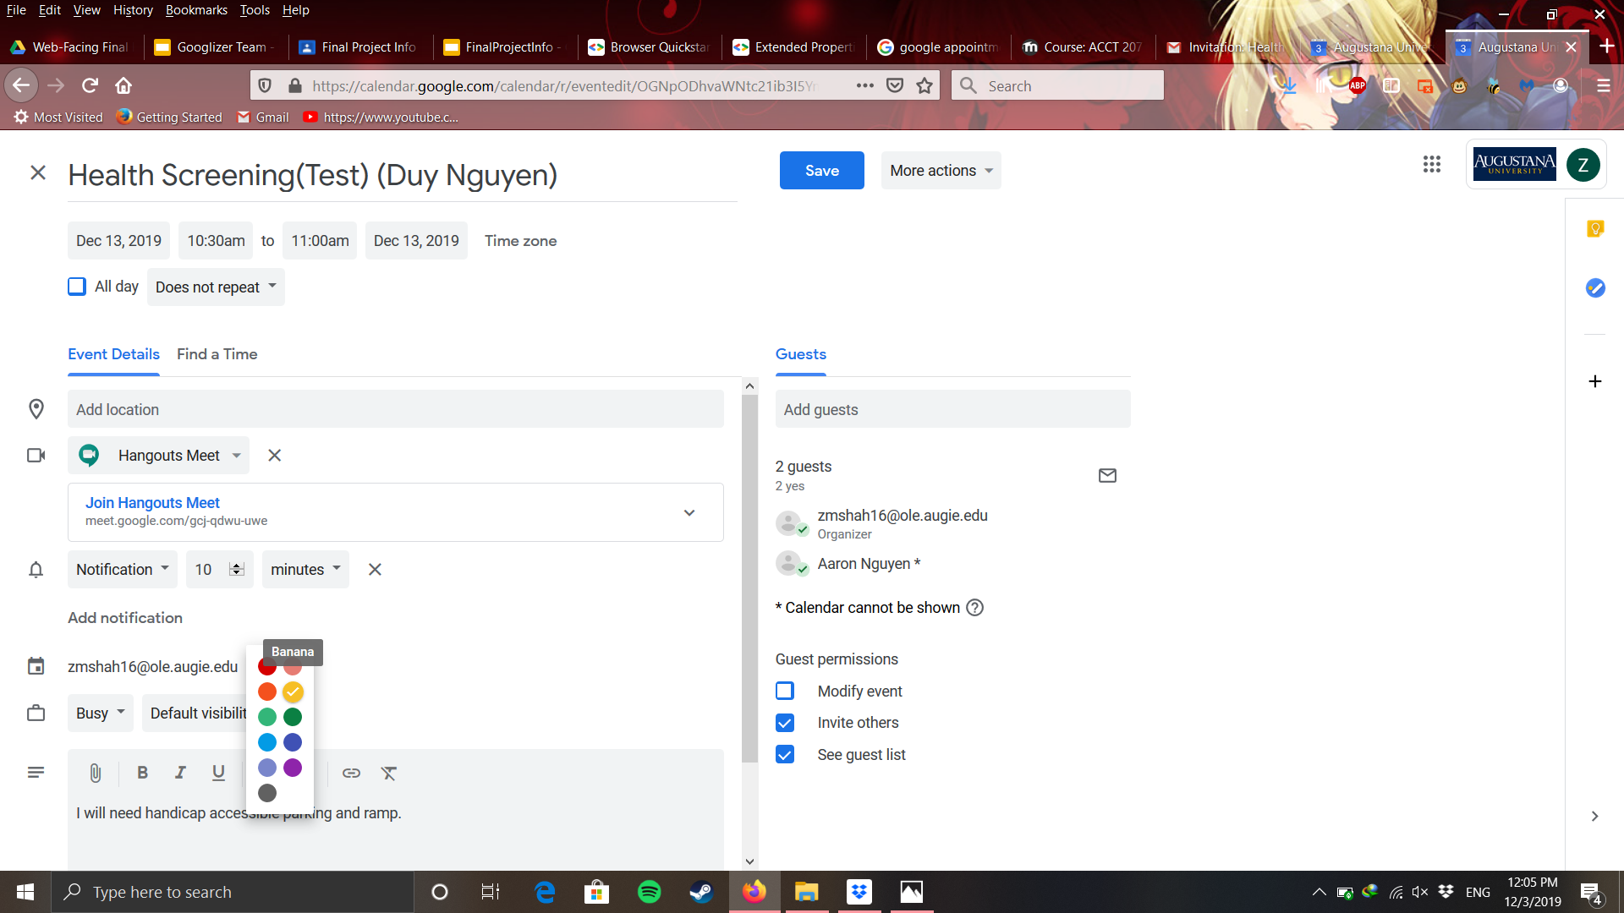
Editing a Booking

Slide 12
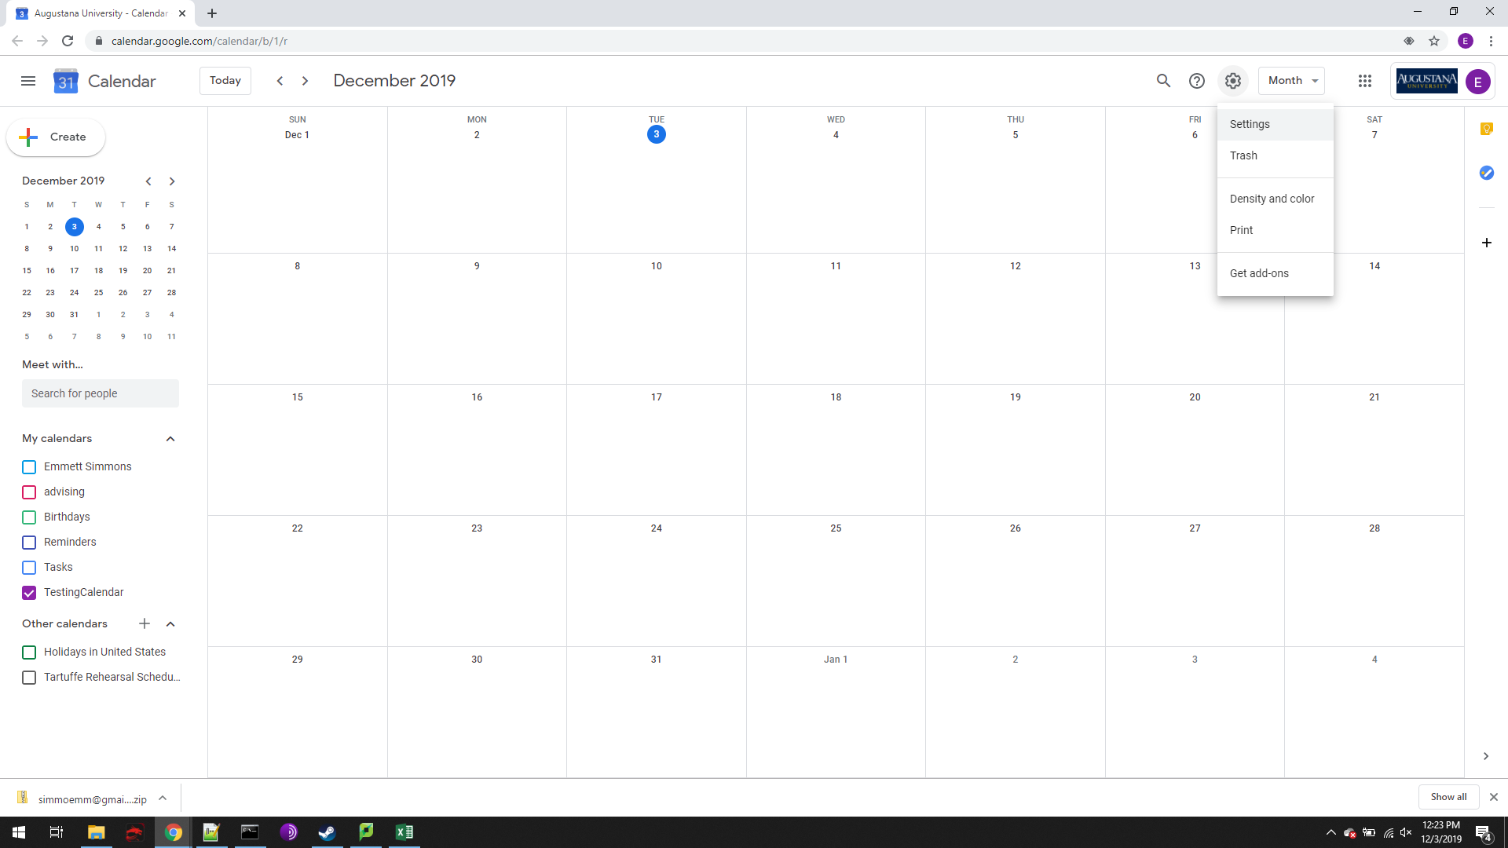
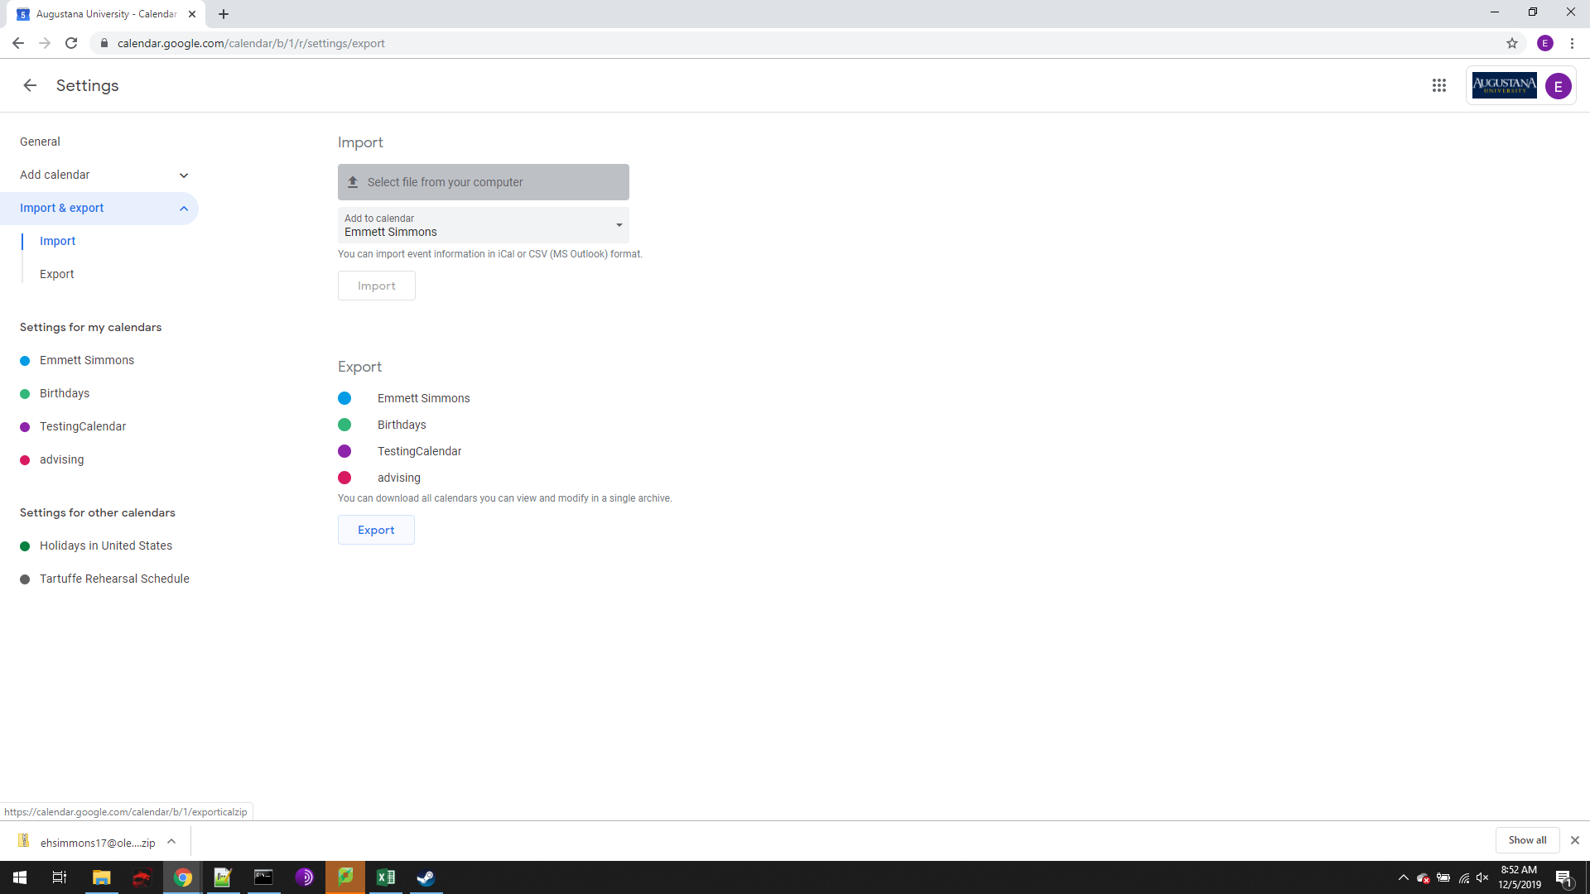
Exporting Calendar to MS Excel

Slide 13
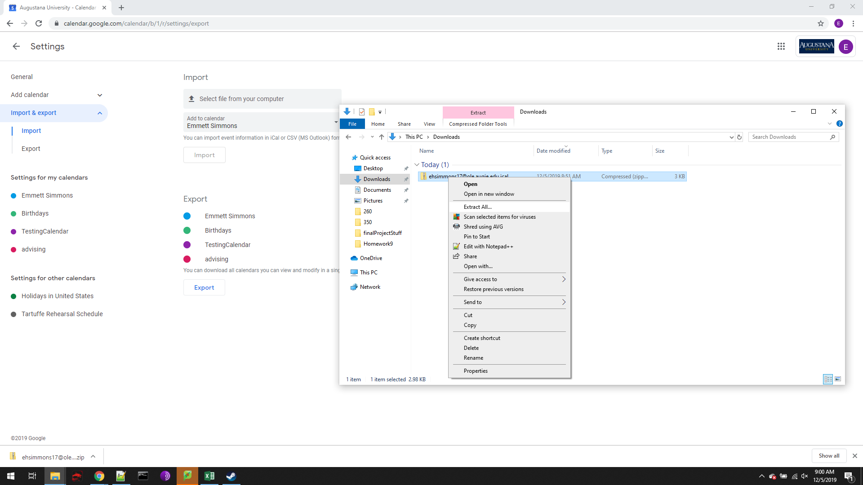
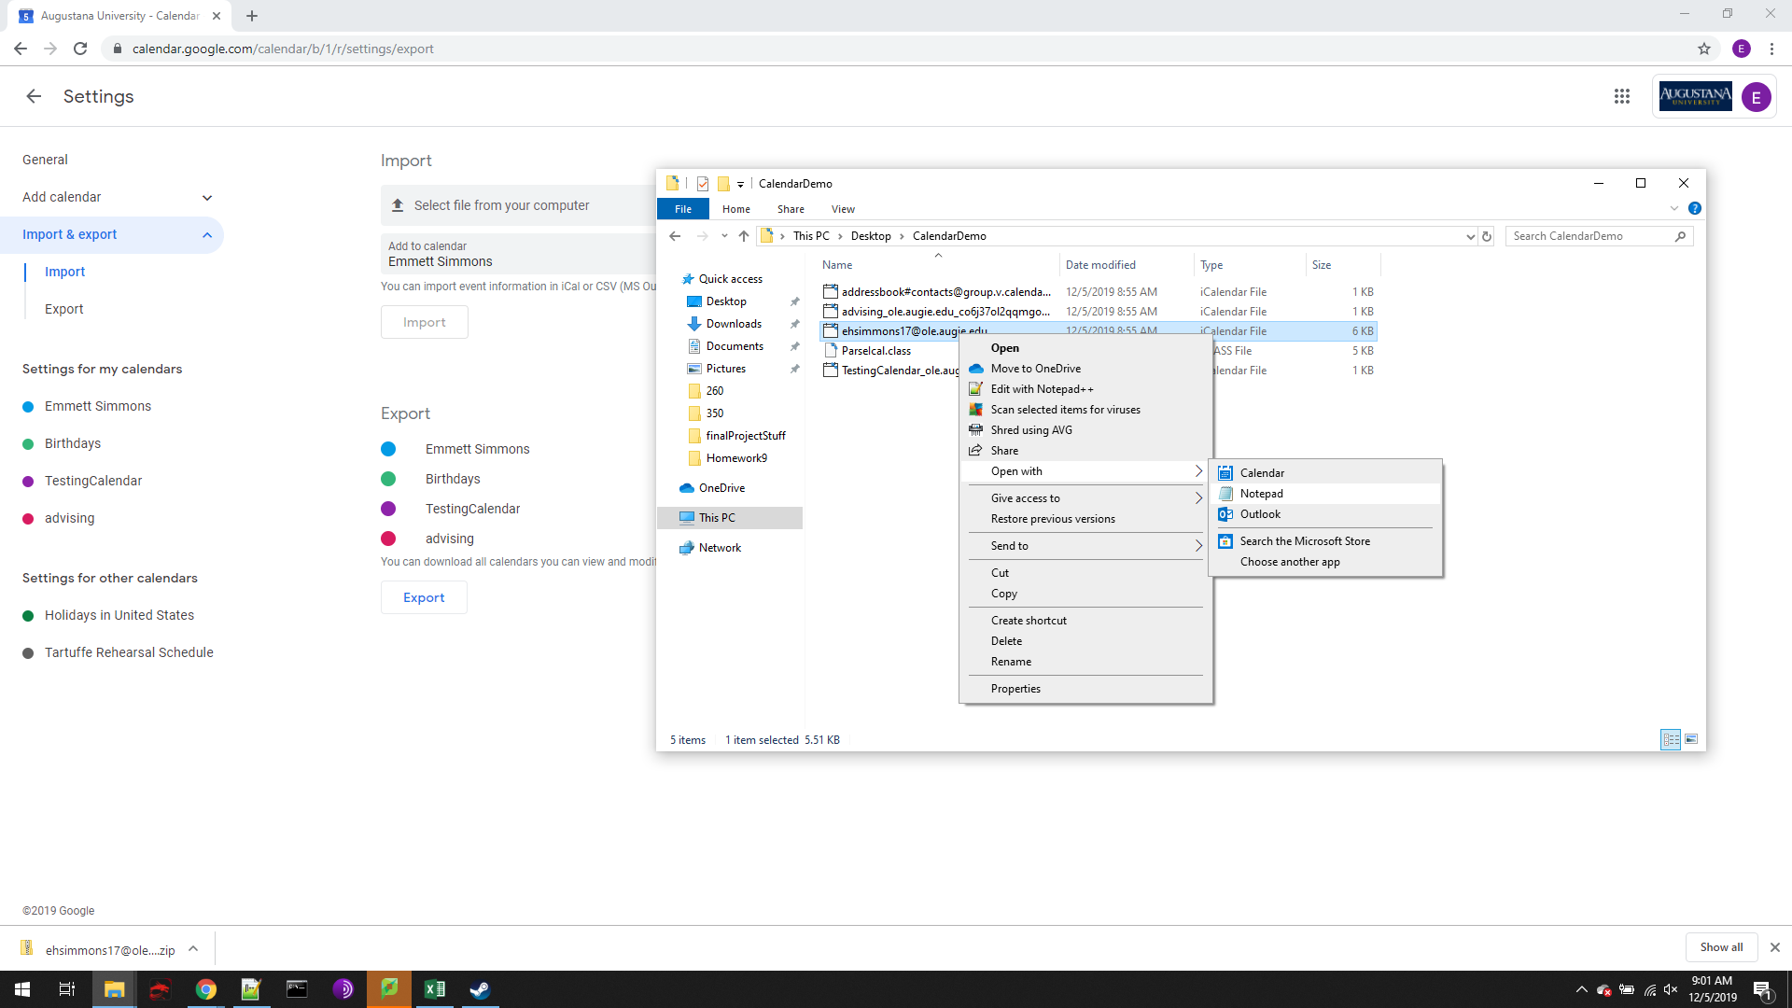
Exporting Calendar to MS Excel

Slide 14
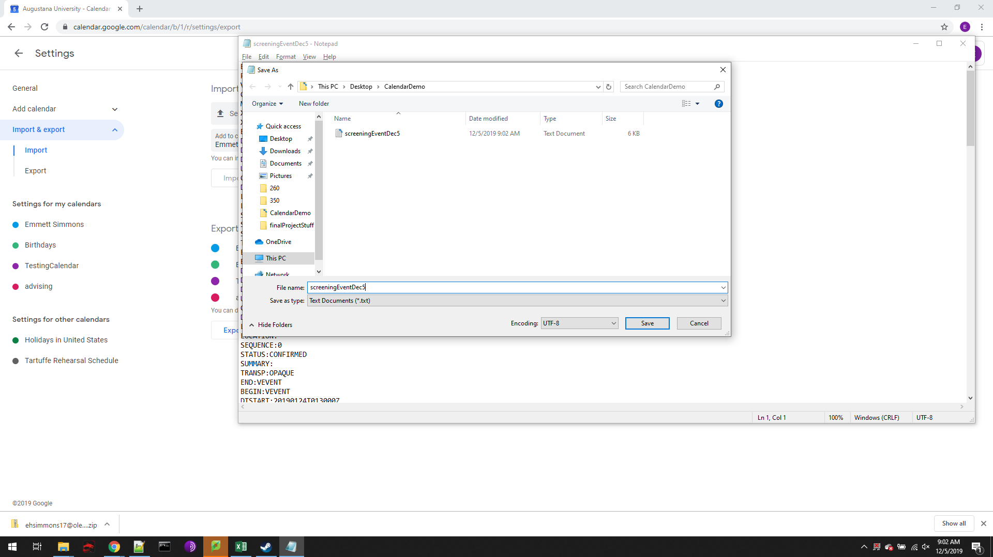
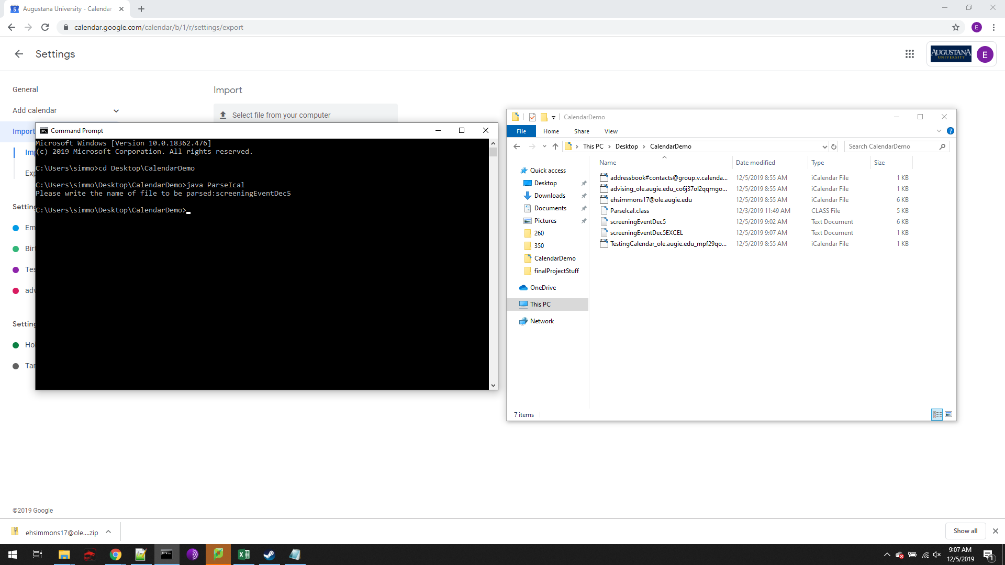
Exporting Calendar to MS Excel

Slide 15
Employee

Slide 16
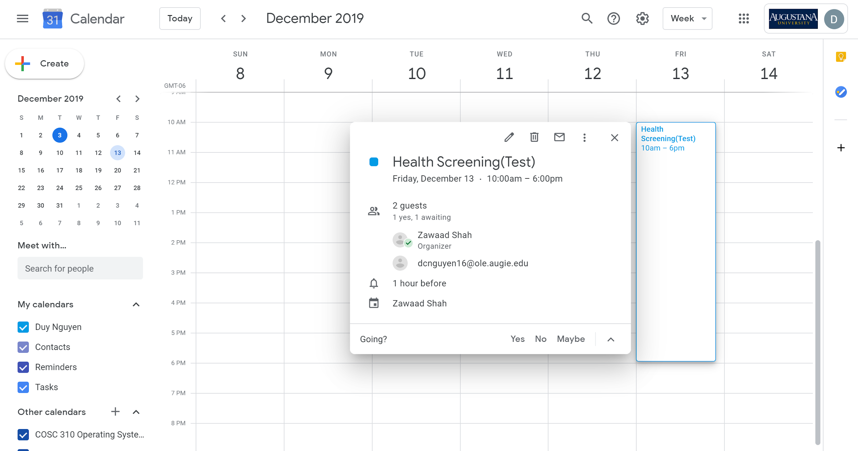
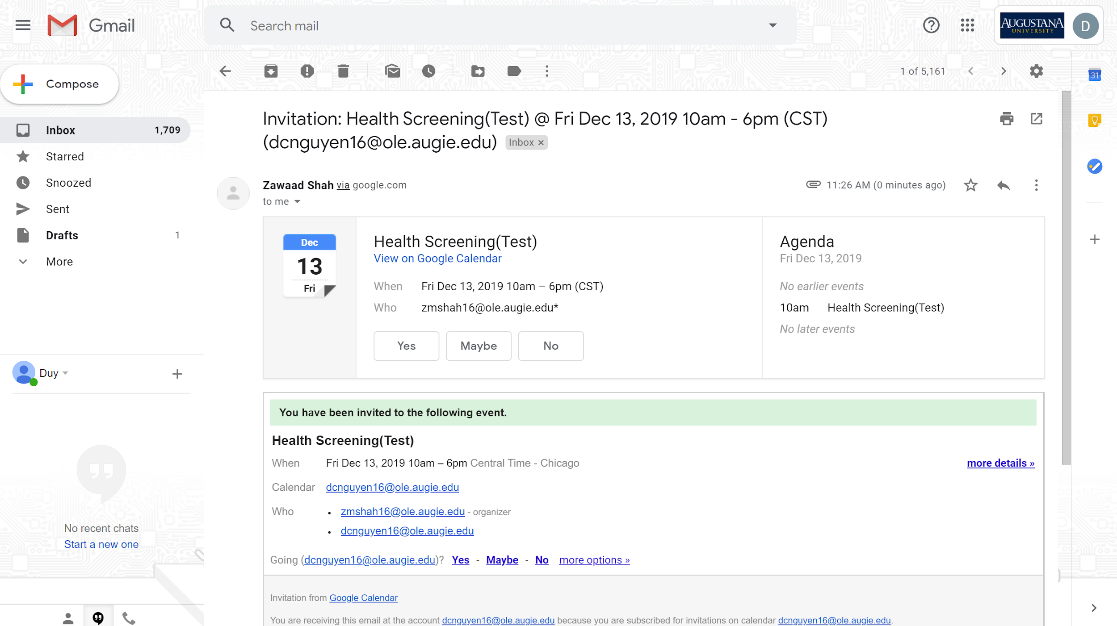
Booking a Screening
Notes:
1st slide: Invitation to the screenings
2nd slide: Viewing the appointment slots on Calendar

Slide 17
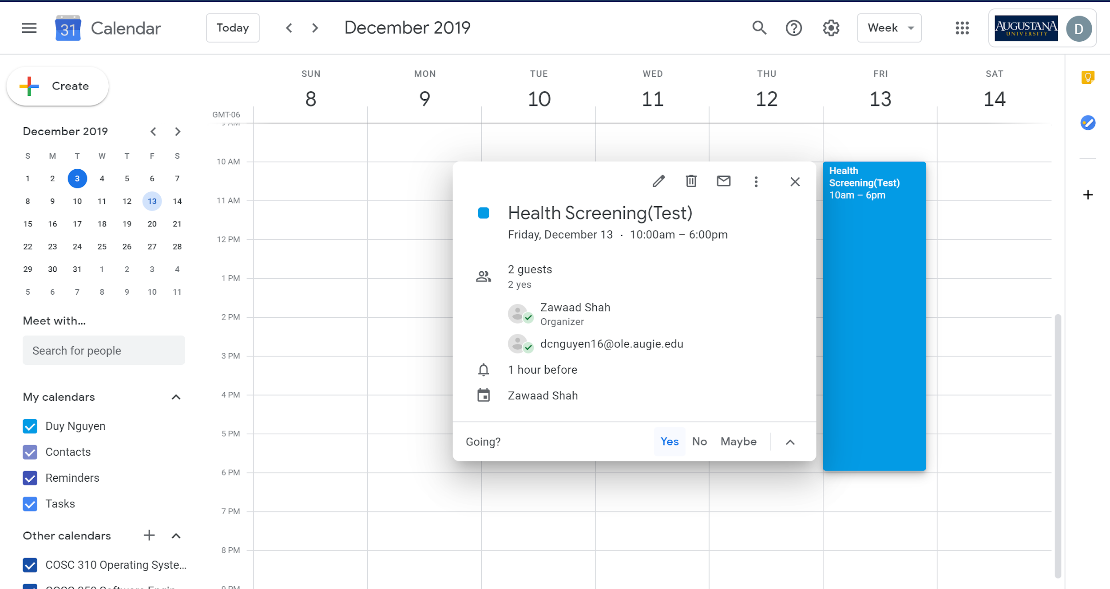
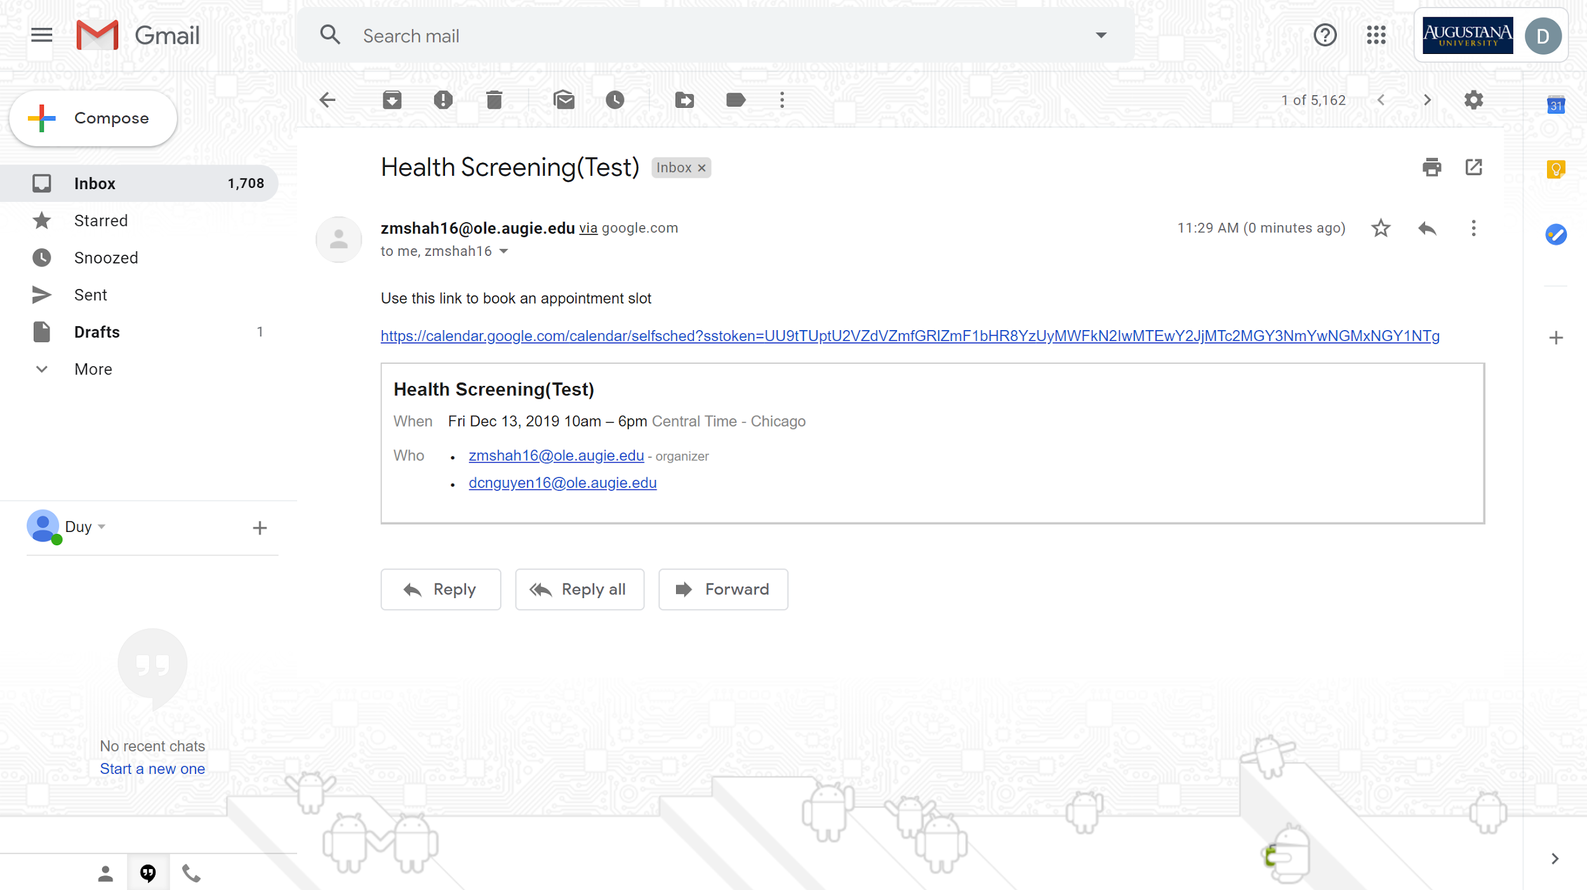
Notes:
1st: Accepting the invitation
2nd: Notification to book a time slot after accepting

Slide 18
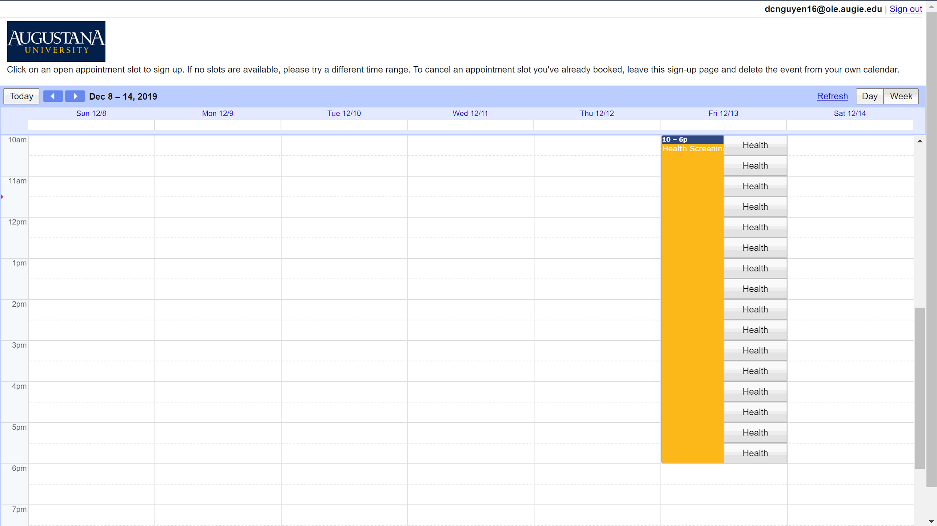
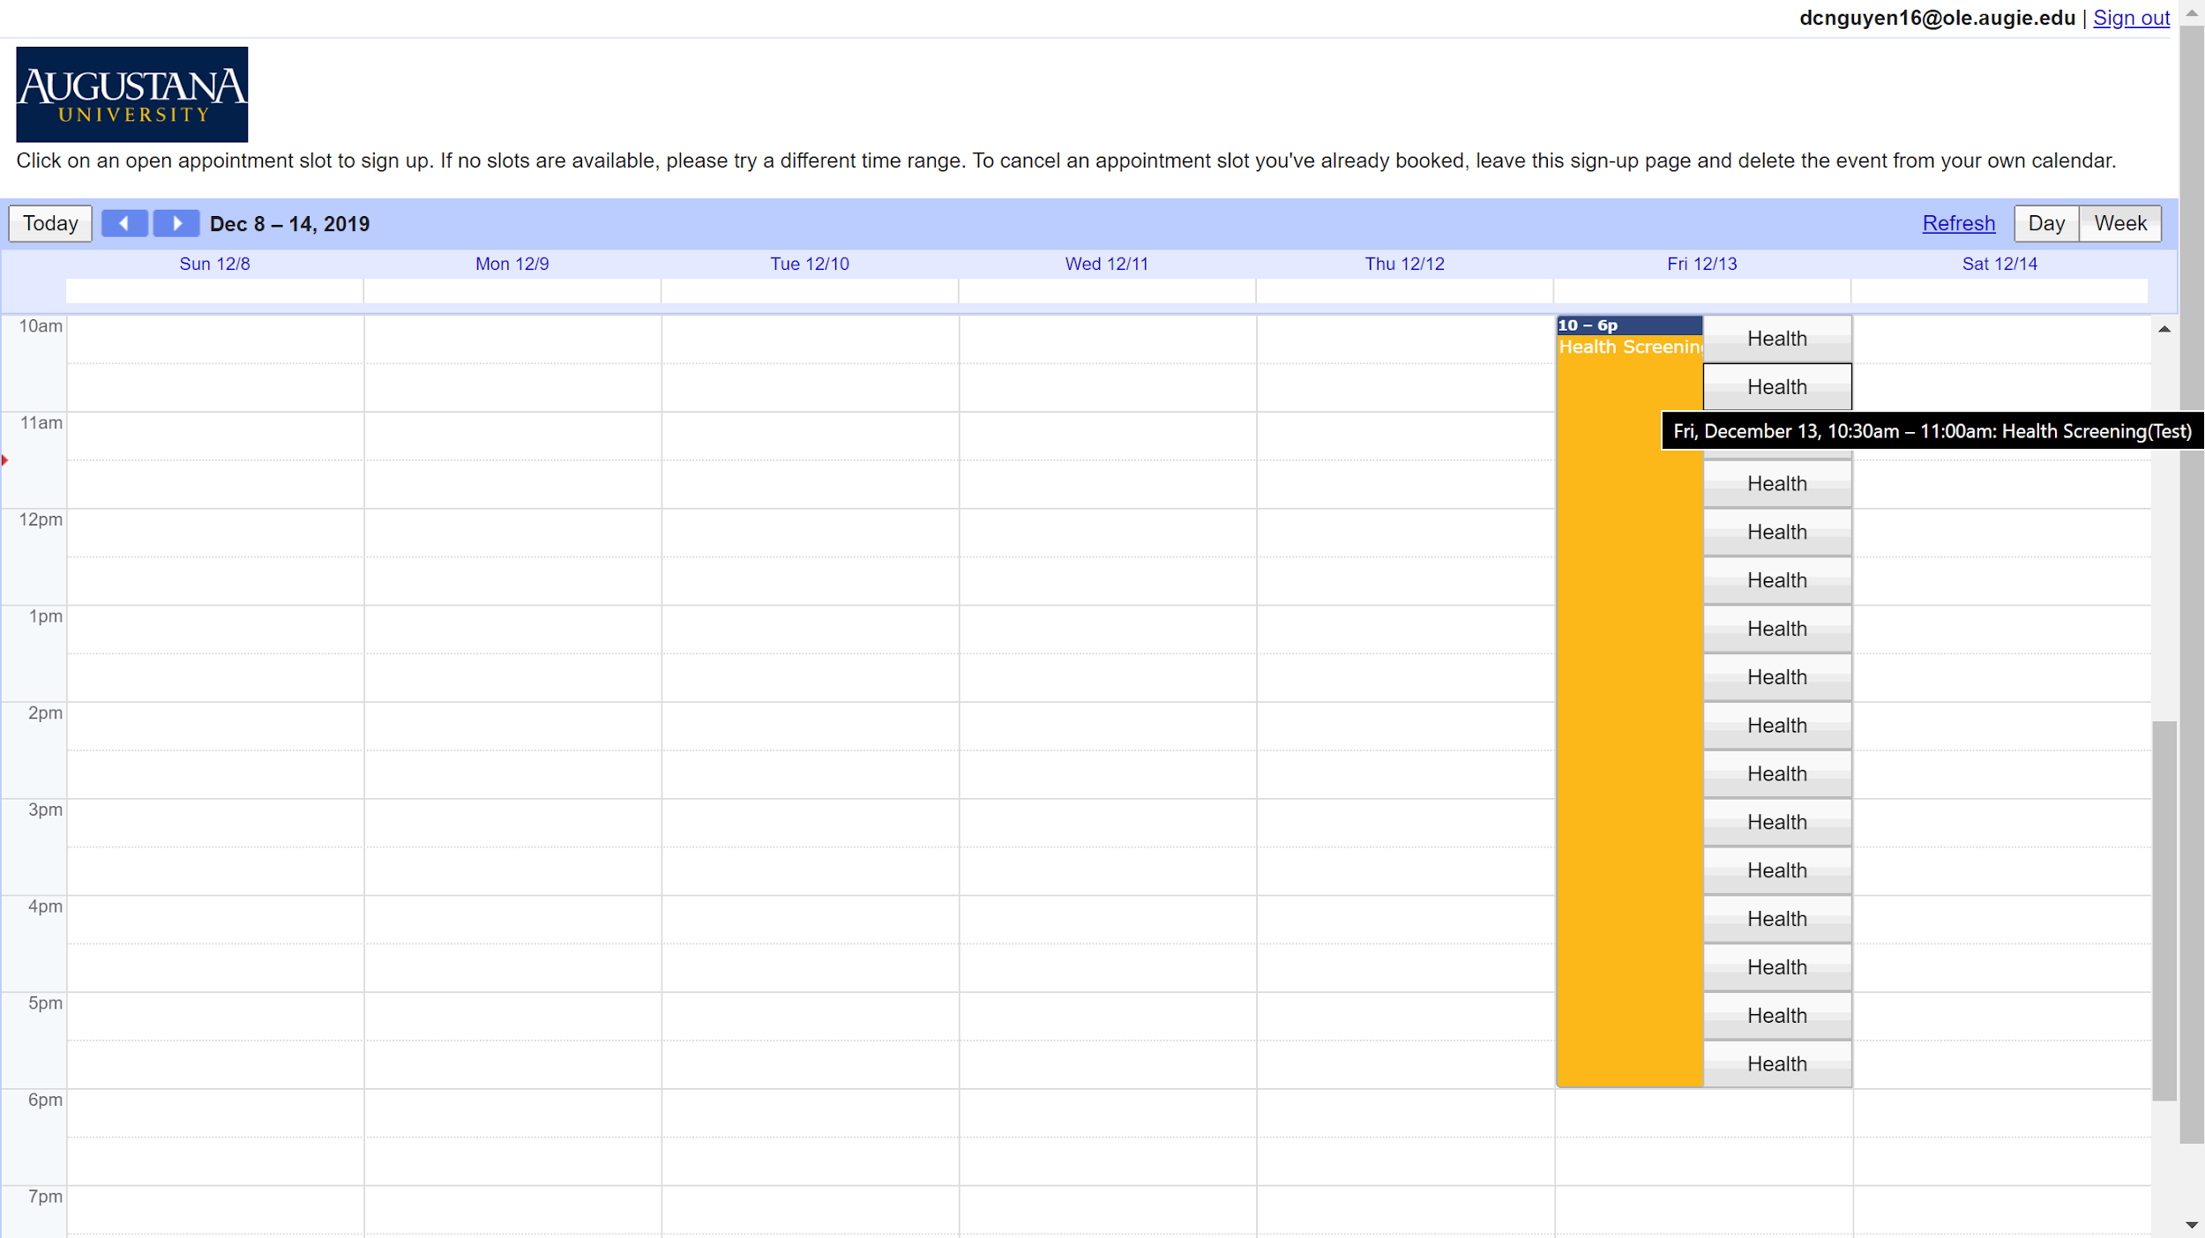
Notes:
1st: Viewing the time slots on Calendar
2nd: Choosing a time slot

Slide 19
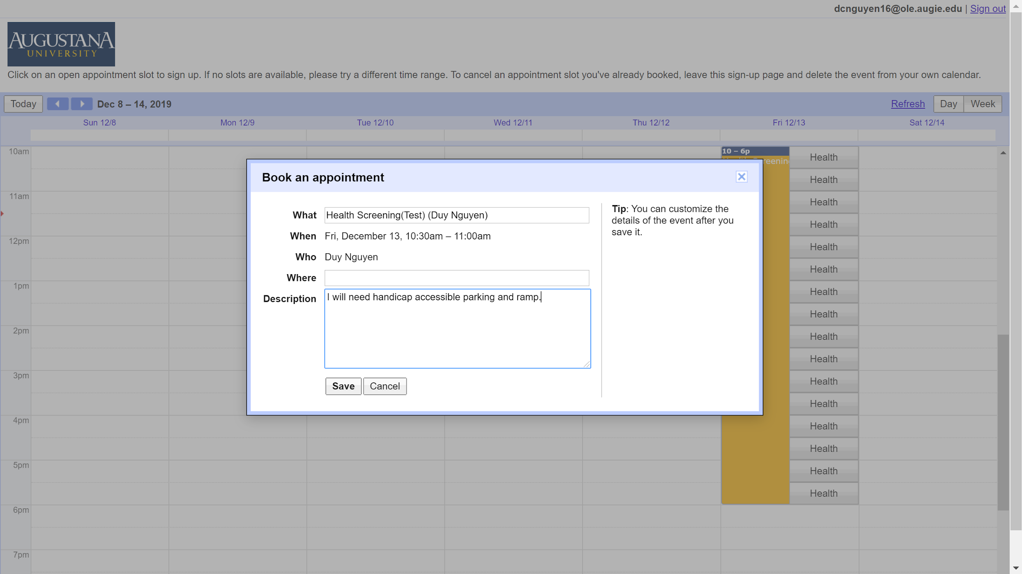
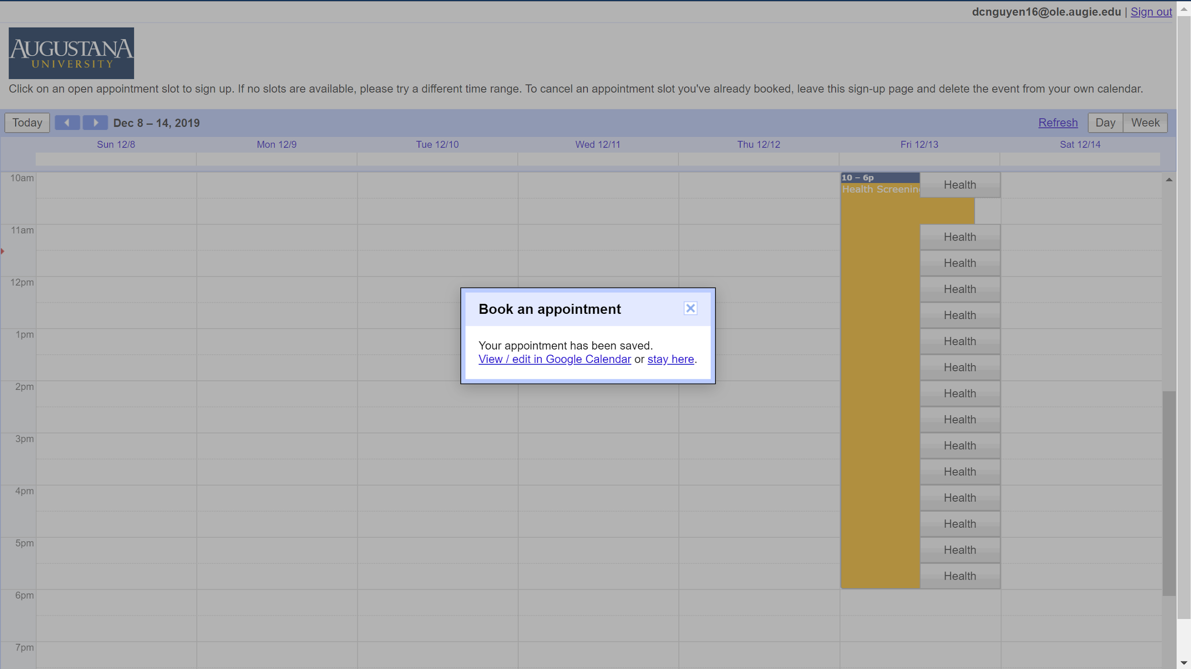
Notes:
1st: Booking and adding user comments
2nd: Confirmation of booking

Slide 20
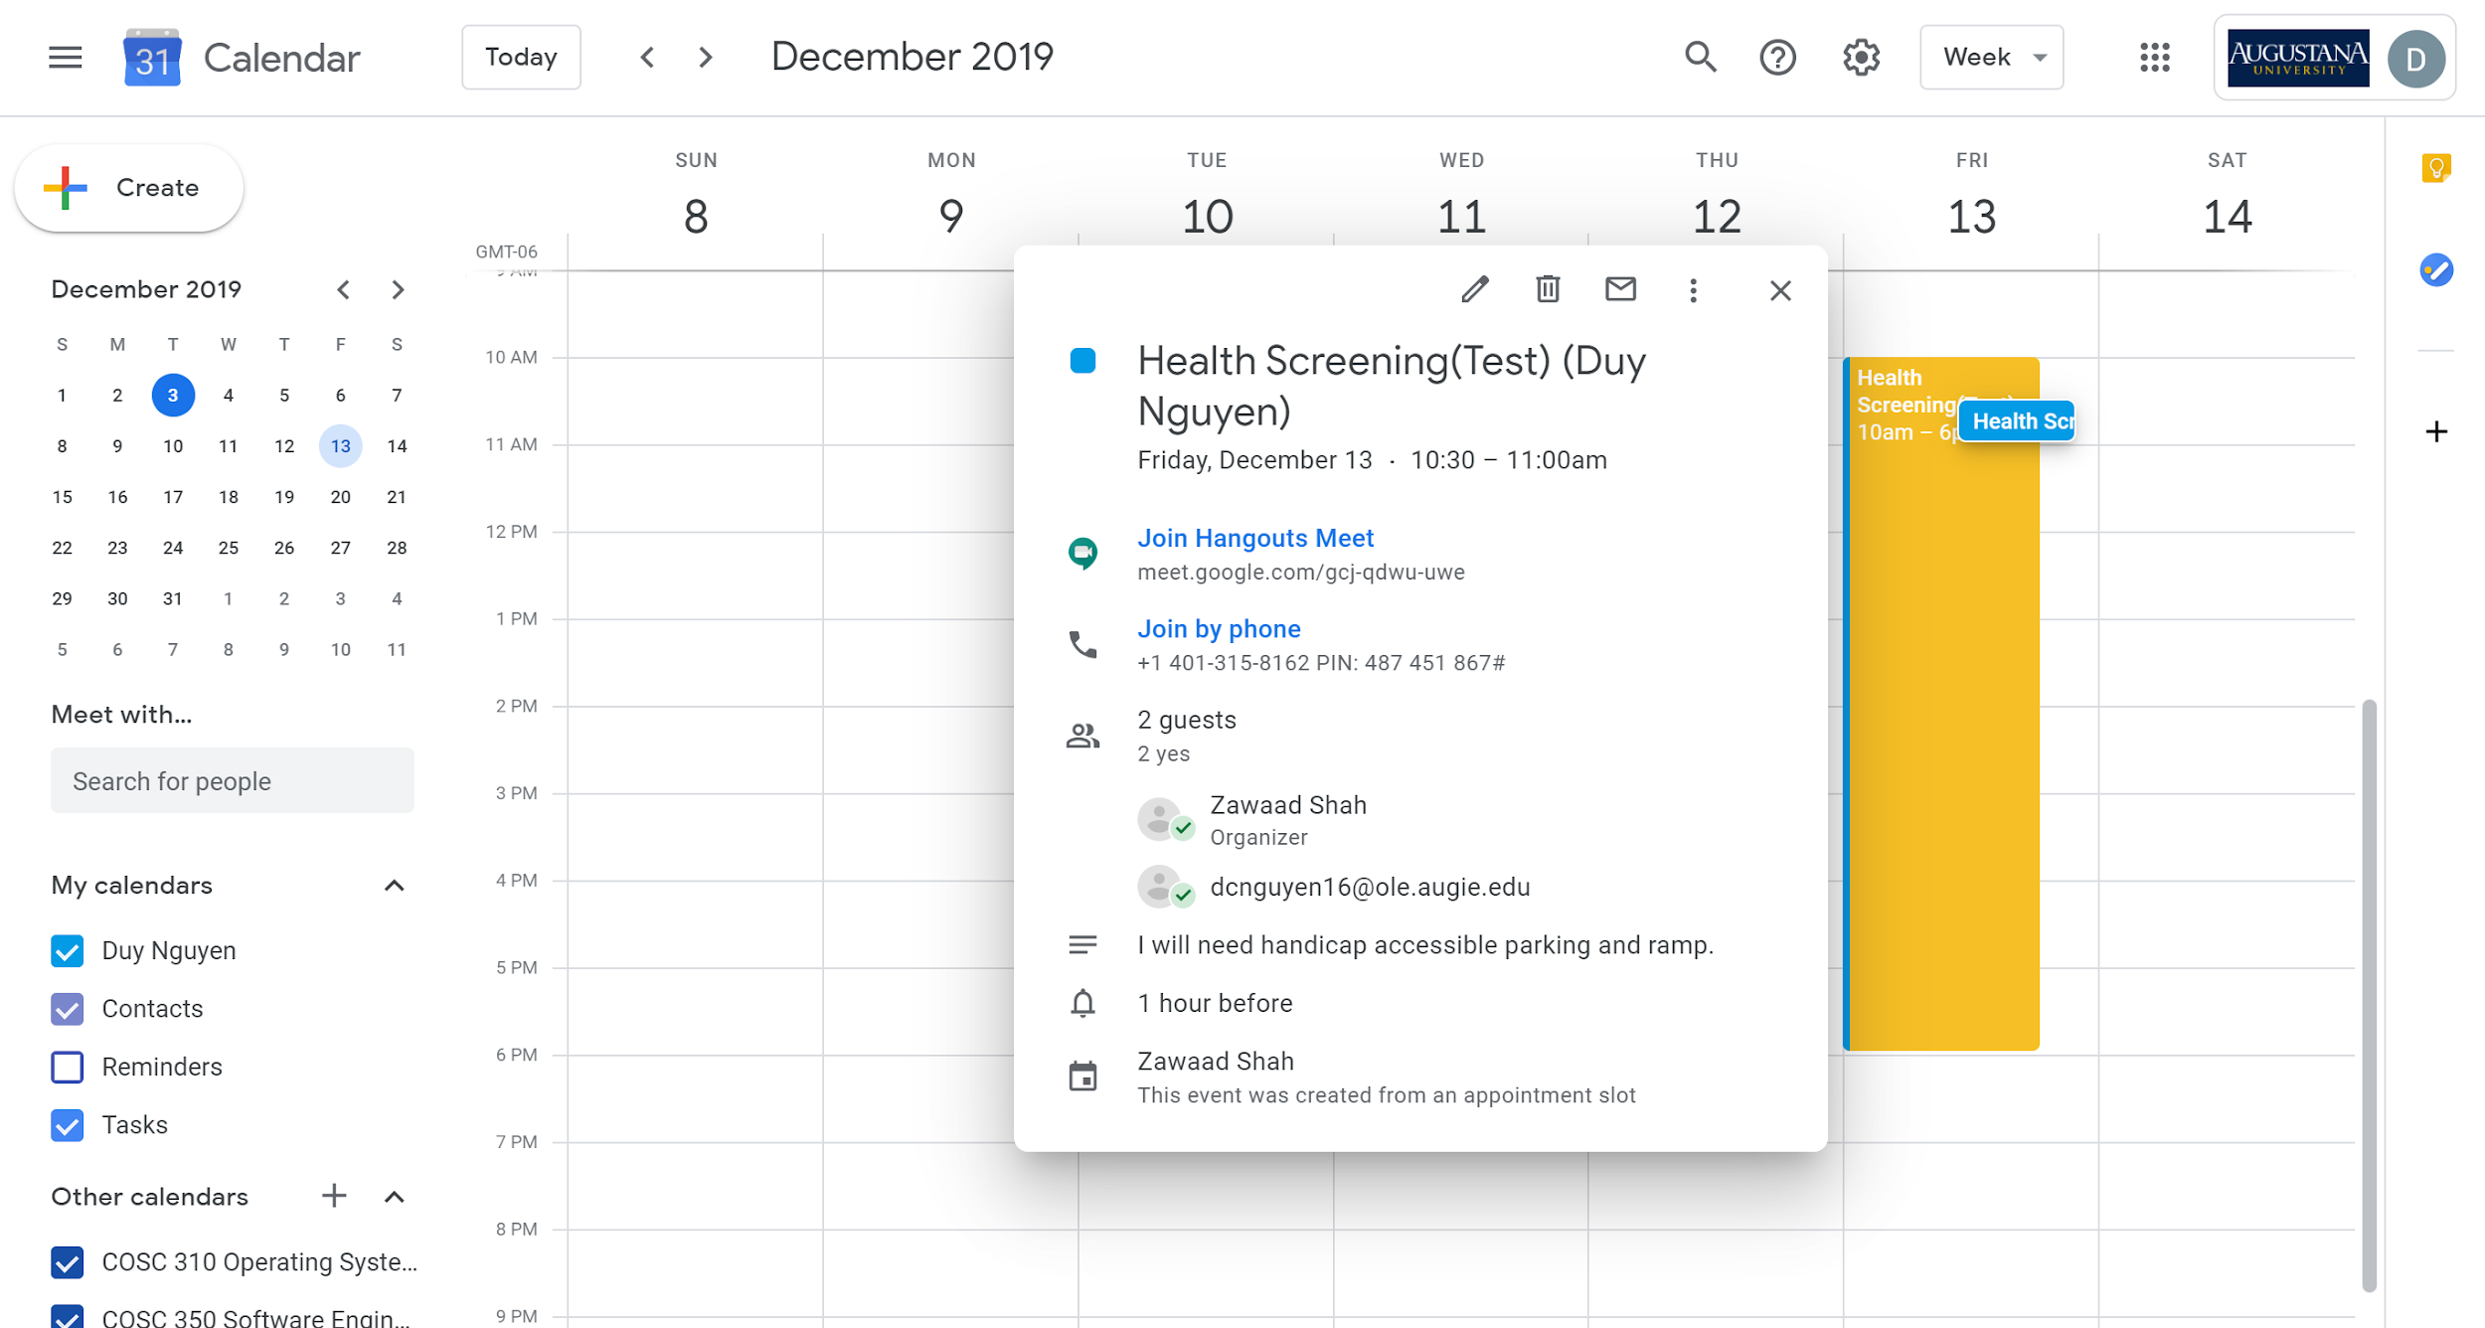
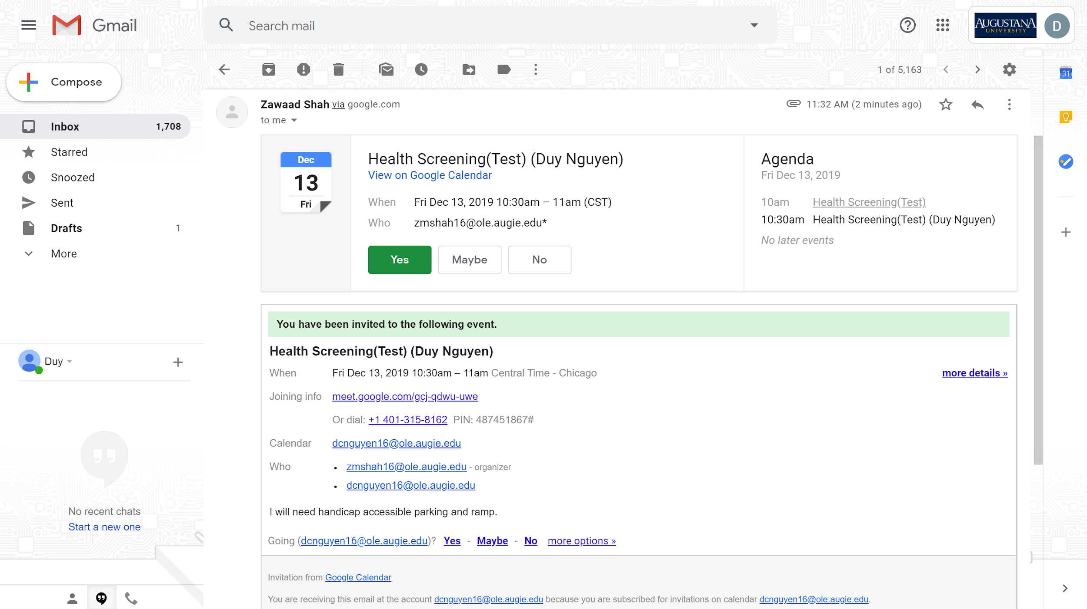
Notes:
1st: Notification that the time slot is booked
2nd: Viewing the booked time slot on Calendar

Slide 21
Future

Slide 22
Appearance
Enhance look and feel
Have the screening be viewable only by the day

Slide 23
Separate Application
Possible mobile application
Developing a third party desktop application to create and automate the scheduling process

